Slide 1



Excel Database Management Workshop

Slide 2
Lecture Outline
Databases
Form Tool
Sorting
Filtering
Lookup & Reference Formulas
INDEX
MATCH
VLOOKUP and HLOOKUP

Slide 3
Databases
A database is an organized collection of data
In Excel, normally represented as a table with
Each row corresponding to a record and
Each column corresponding to a field that gives specific information about each record
In this lecture, we’ll look at formulas and other functionalities in Excel for seeking out information within a database.
Suggestion: check out the Excel file L4 Examples-Applicants.xlsx on Moodle

Slide 4
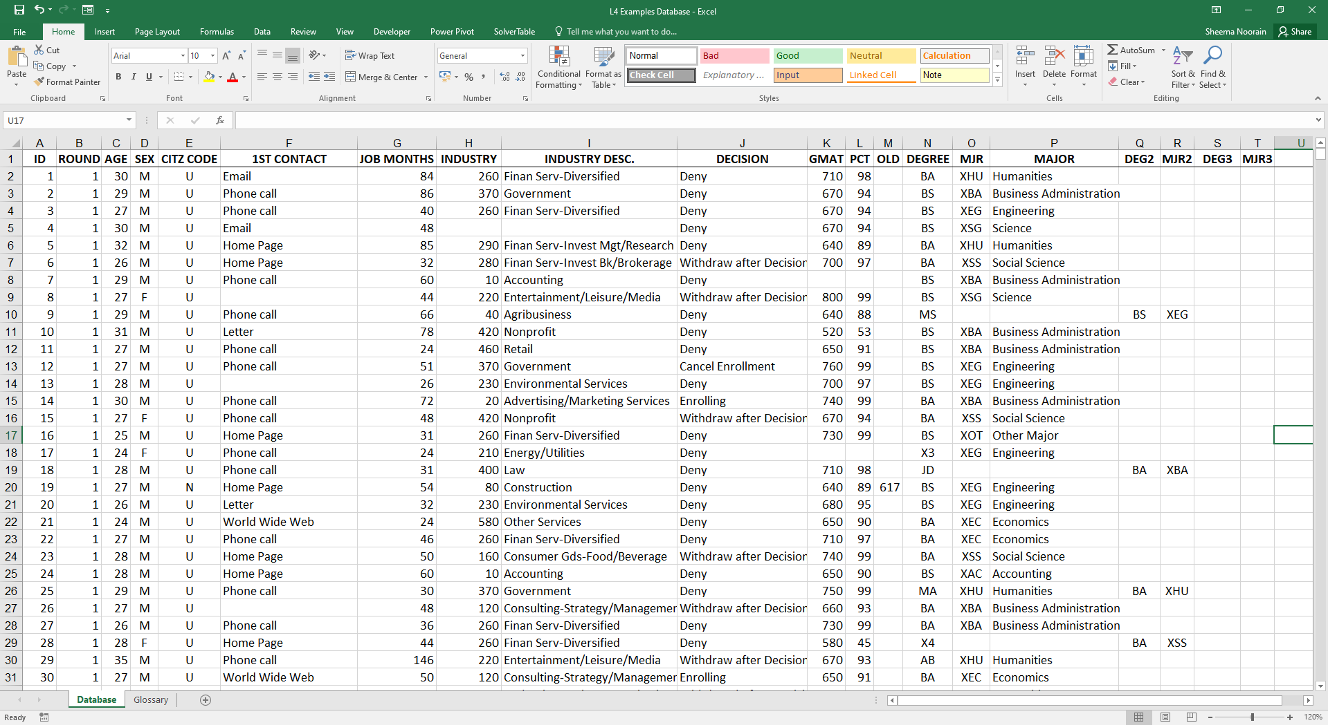
Applicants databases

Slide 5
Finding facts from databases
Excel has built-in functionalities for searching out information in a database
Database Form Used to examine and search for, add or delete records in a database | Filter Used to probe a database and extract a portion of it
Sort Used to sort records according to one or more criteria | Pivot Table Used to summarise data in simple tables

Slide 6
Searching and editing
Add the Form button:
Click the arrow next to the Quick Access Toolbar and then click More Commands.
In the Choose commands from drop-down box, click All Commands.
Select the Form button from the list, then click Add, then OK
Use the Form to visualize single records
Use the criteria button in the form to display the records meeting one or multiple criteria

Slide 7
Sorting
Highlight area to be sorted
On the Data tab, in the Sort & Filter group, click on Sort.
In the Sort dialog box, under Column, in the Sort by box, select the column that you want to sort.
Under Sort On, select the type of sort. Do one of the following:
To sort by text, number, or data and time, select Values.
To sort by format, select Cell Colour, Font Colour, or Cell Icon.
Under Order, select how you want to sort. Do one of the following:
For text values, select A to Z or Z to A.
For number values, select Smallest to Largest or Largest to Smallest.
For date or time values, select Oldest to Newest or Newest to Oldest.

Slide 8
Sorting
You can sort data on one or more columns.
To add another column to sort by, on the sort dialog box, click Add Level, and then repeat steps one through three (from the previous slide).
You can also include or not a header row which does not get sorted
You can also sort from left to right by clicking on “Options” in the sort dialog box.

Slide 9
Sorting
Question: In the Applicants database, how does work experience vary among the applicants in successive rounds?
We can sort first by Round, then by Industry, and then by Job Months to get a sense of how applications arrive over time from people in different industries and with different lengths of service in their current jobs
Example: The applicants with relatively fewer months in advertising tend to apply in the first two rounds.

Slide 10
Filtering
Select a database
On the Data tab, under the Sort & Filter group, click Filter
Click the arrow in a given column header
Select Text Filters or Number Filters depending on the type of data in the column
To undo filtering, just click Filter again

Slide 11
Filtering
Question: In the Applicants database, isolate the applicants who worked in either nonprofit or government sectors and had GMAT scores above 700
After selecting the whole area and hit the Filter button
Tick only the “Nonprofit” and “Government” categories for the header INDUSTRY DESC.
For the GMAT header, select Number Filters → Greater Than
Observation: A total of 39 applicants meet these criteria

Slide 12
Lookup & Reference
Often times, you need to extract values or find where values are in table
Excel has various formulas for doing just this
In what follows, we’ll look at 3 of the most important “Lookup & Reference” formulas in Excel:
INDEX
MATCH
VLOOKUP and HLOOKUP

Slide 13
INDEX formula
INDEX is a useful formula for picking the number you want out of an array
Format:
=INDEX(array, r, c)
Returns the value in the r^{th} row and c^{th} column of the designated array
 | A | B | C
1 | 7 | 19 | 22
2 | 5 | 16 | 23
3
4 | =INDEX(A1:C2, 2, 3)
The formula in A4 will return the value 23

Slide 14
INDEX formula continued
If the array has only one row or column then you only need one “indexing” parameter
Format:
=INDEX(array, index)
 | A | B | C
1 | 7 | 19 | 22
2 | 5 | 16 | 23
3
4 | =INDEX(A1:C2, 2)
The formula in A4 will return the value 19

Slide 15
MATCH formula
The MATCH formula returns the relative position of an item in an array that “matches” a specified value
Format:
=MATCH(value, array, type)
 | A | B | C
1 | 7 | 19 | 22
2 | 5 | 16 | 23
3
4 | =MATCH(19, A1:C2, 0)
The formula in A4 will return the value 2

Slide 16
Look-up tables
Often times, the relationship between two variables is not given by a simple function
E.g., price discounts on large orders (£10/item for order ≤ 100, £8/item for orders >100)
E.g., labour costs in terms of hours worked (“standard rate,” “time and a half,” etc.)
You could use nested “IF” statements:
=IF(B5<=8, 5.00, IF(B5<=12, 7.50,IF(B5<=16, 8.75, 10)))

Slide 17
Look-up tables
Nested “IF” statements are cumbersome and prone to error!
Usually, much easier to lay out the data in a table (i.e. a mini database) and then use HLOOKUP or VLOOKUP to find the info you want
 | A | B | C | D | E
1 | Hours per day | 0 | 8 | 12 | 16
2 | Pay rate | £5.00 | £7.50 | £8.75 | £10.00
3
4 | Hours today | 11
5 | Pay rate today | £7.50

Slide 18
HLOOKUP and VLOOKUP
HLOOKUP is useful for retrieving values in a table when records are organised horizontally
It looks in the top row of a table for a “match” and then moves down the column, returning the value from the specified row
VLOOKUP is useful for retrieving values in a table when records are organised vertically
It looks in the first column of a table for a “match” and then moves across the row, returning the value from the specified column

Slide 19
Look-up tables
In the previous example, if we want to look up cell B4 (i.e. 11) in the array B1:E2, we’d type
=HLOOKUP(B4, B1:E2, 2, true)
The value 11 is then compared successively with 0, 8, 12, 16
8 is the first value in the top row ≥ 11, so drop down from the 8 to row 2 and return the value £7.50
Watch out - you can fall off the left-hand end of the table and get an error!

Slide 20
Look-up tables: matching text
Look-up tables do not just work with numerical values, they also work with text as well
The formula in cell B5 is simply:
=HLOOKUP(B4, B1:E2, 2, false)
 | A | B | C | D | E
1 | Employee | Tom | Dick | Harry | Mary
2 | Wage | £7.00 | £9.00 | £8.00 | £9.50
3
4 | Who is working? | Tom
5 | Wage | £7.00

Slide 21
Look-up tables: matching text
When you have text in the top row, you need a perfect match, no interpolation is possible
The final “false” parameter ensures a perfect match

